Slide 1
WORKSHOP
CSS
The Basic of Cascading Style Sheets

Slide 2
Rules
Thou shall asketh thy question if thou hast one
Thou shall not laugh at questions of others
The world existeth no stupid questions
Existeth only people who brave not to asketh
Every man that hath attained to the use of reason, is supposed to know, he ought not to do to another, what he would not have done to himselfe
Thou shalt convenant to follows the common rules

Slide 3
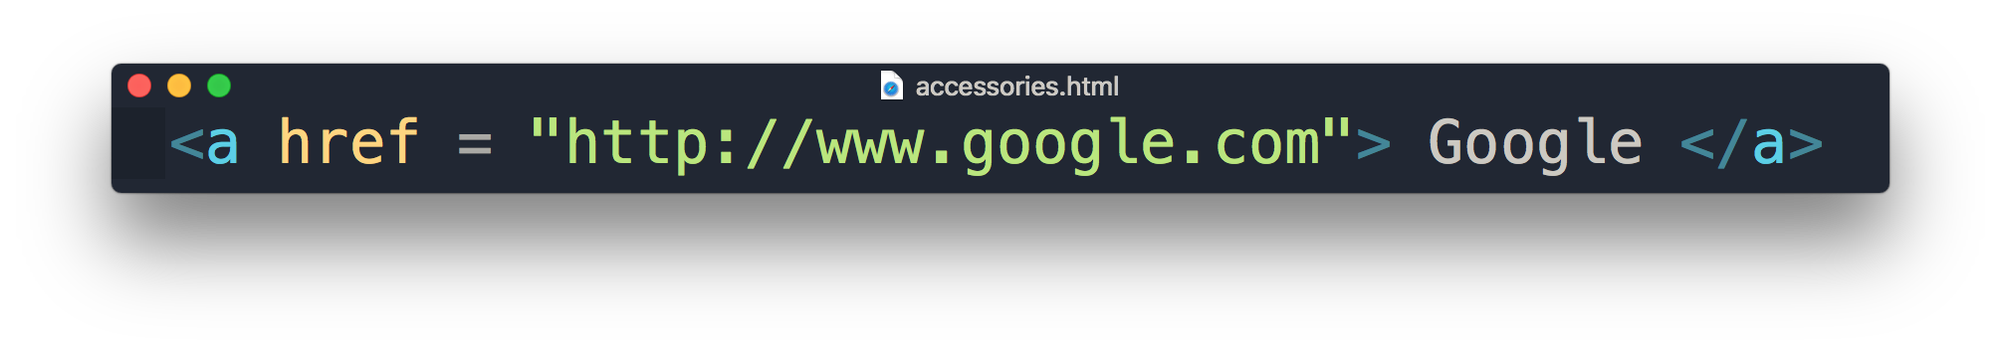
Recap HTML
Attribute
Content
Element

Slide 4
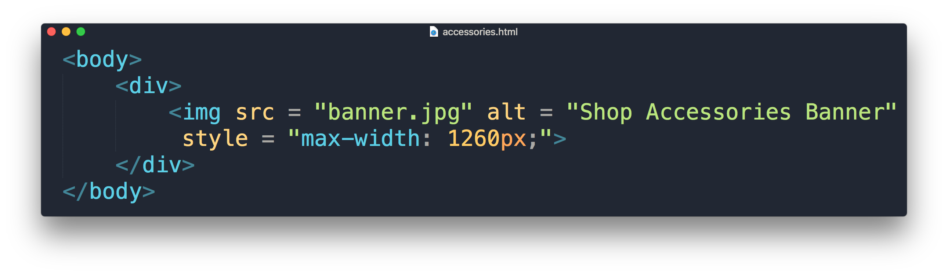
Cascading Style Sheet
property
value

Slide 5
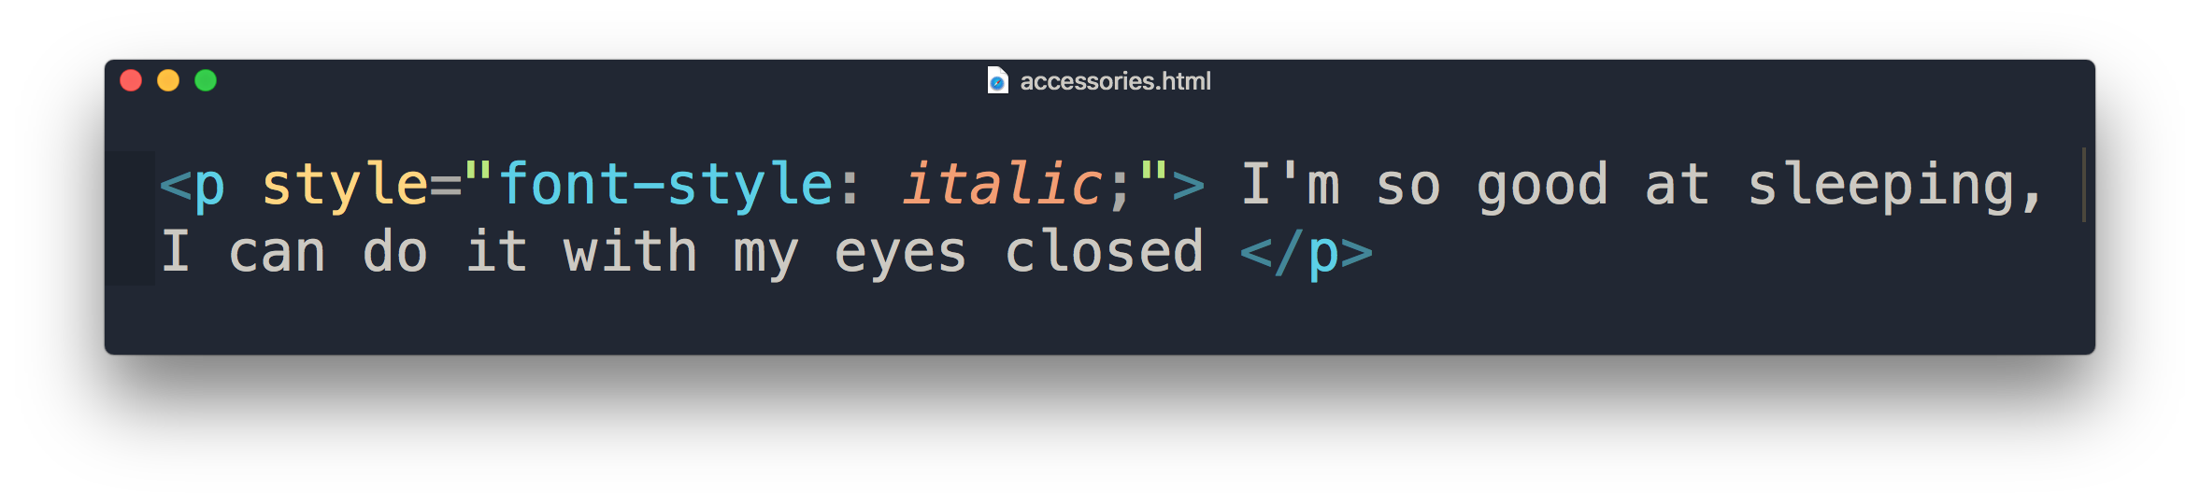
Inline Style Sheet
HTML style attribute
Only applies to specific element
Placed in <body> section

Slide 6
“What if I want it to apply to all <p> element in the rest of the page? "

Slide 7
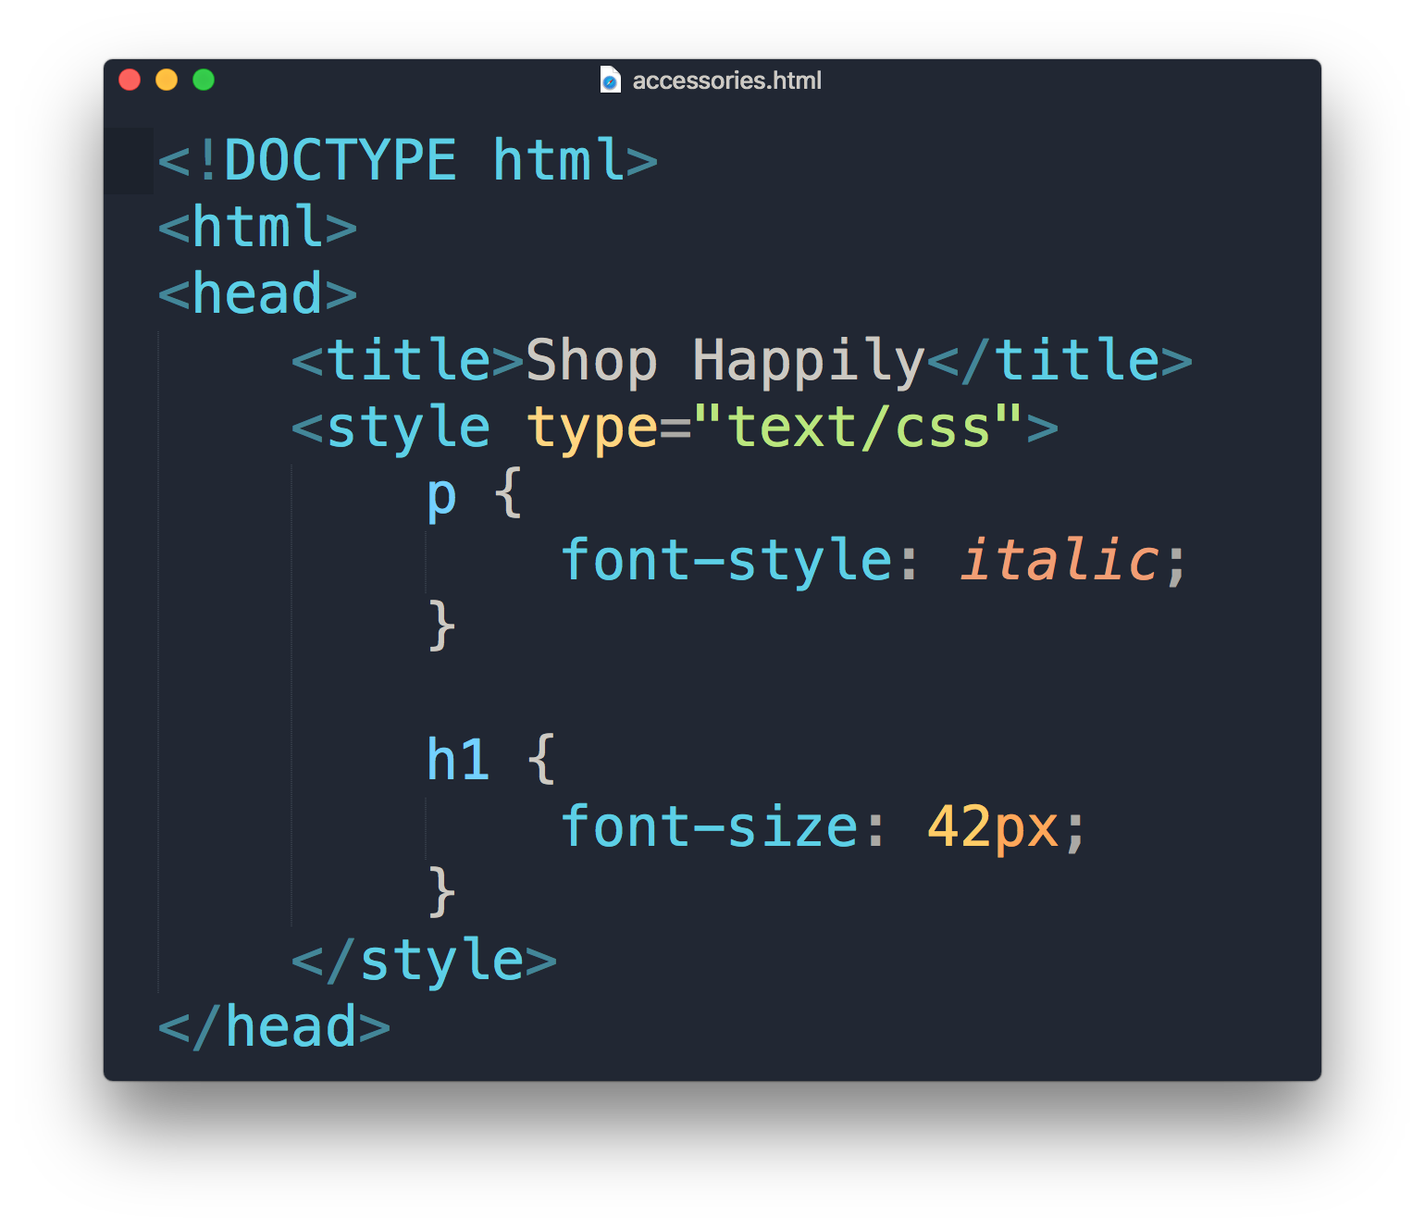
Embedded Style Sheet
HTML <style> element
Placed in <head> section
Requires selector
Only applies to a single HTML page document

Slide 8
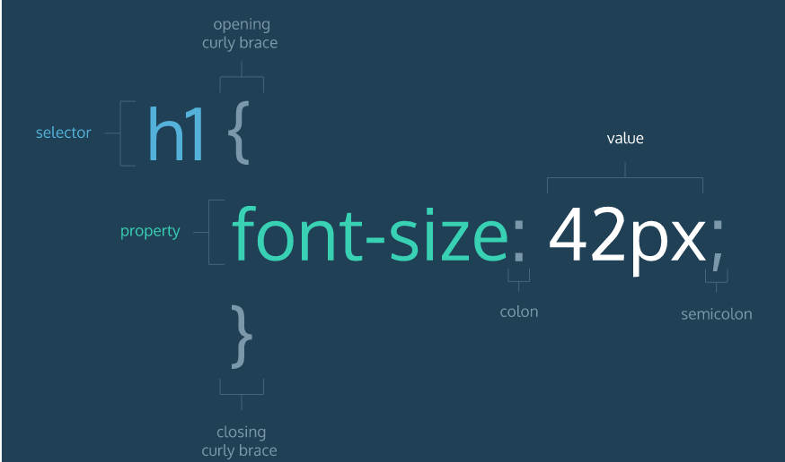
CSS format

Slide 9
“What if I want to apply the same font-size in more than one html page? "

Slide 10
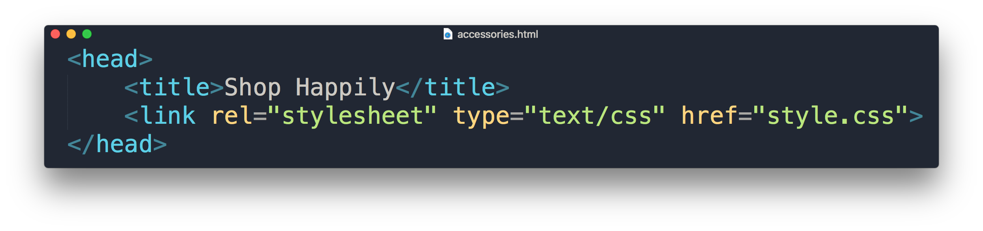
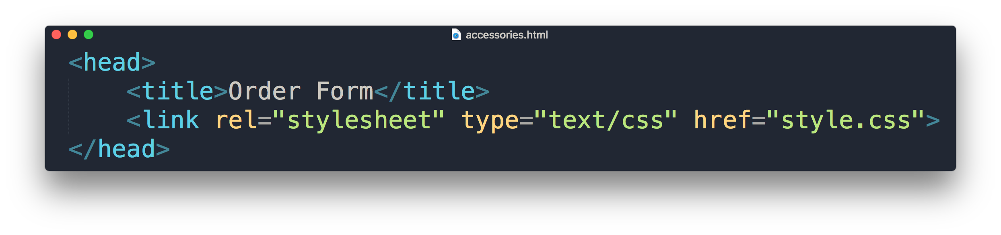
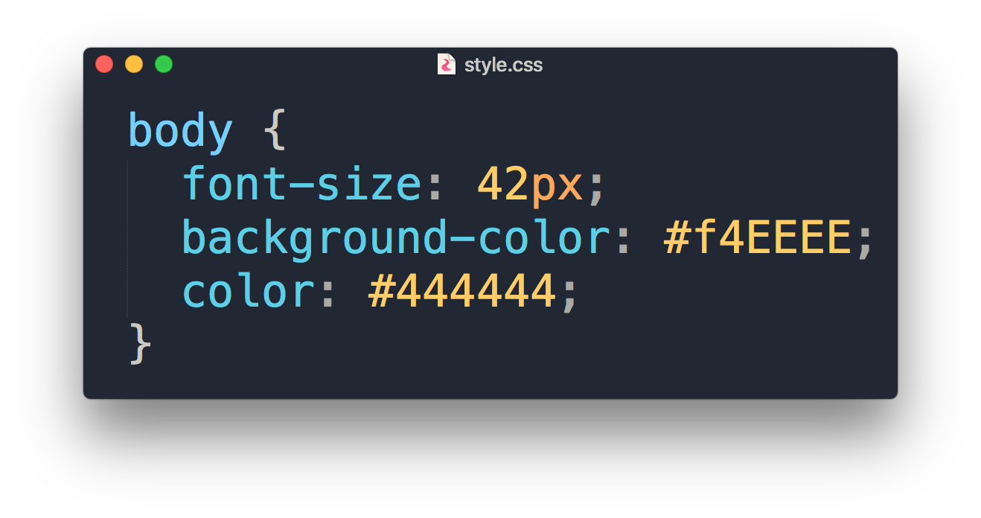
External Style Sheet
Separate HTML & CSS
Placed in <head> section
HTML <link> element to associate with .css file
Requires selector
Applies to multiple HTML page documents
What are these?

Slide 11
Hexadecimal Colors

Slide 12
Comparing Hex with RGB
Hexadecimals counts from 0 ~ 9 then A ~ F
RGB(255,0,0) = #FF0000
RGB(0,255,0) = #00FF00
RGB(0,0,255) = #0000FF
See the pattern?
Red
Green
Blue

Slide 13
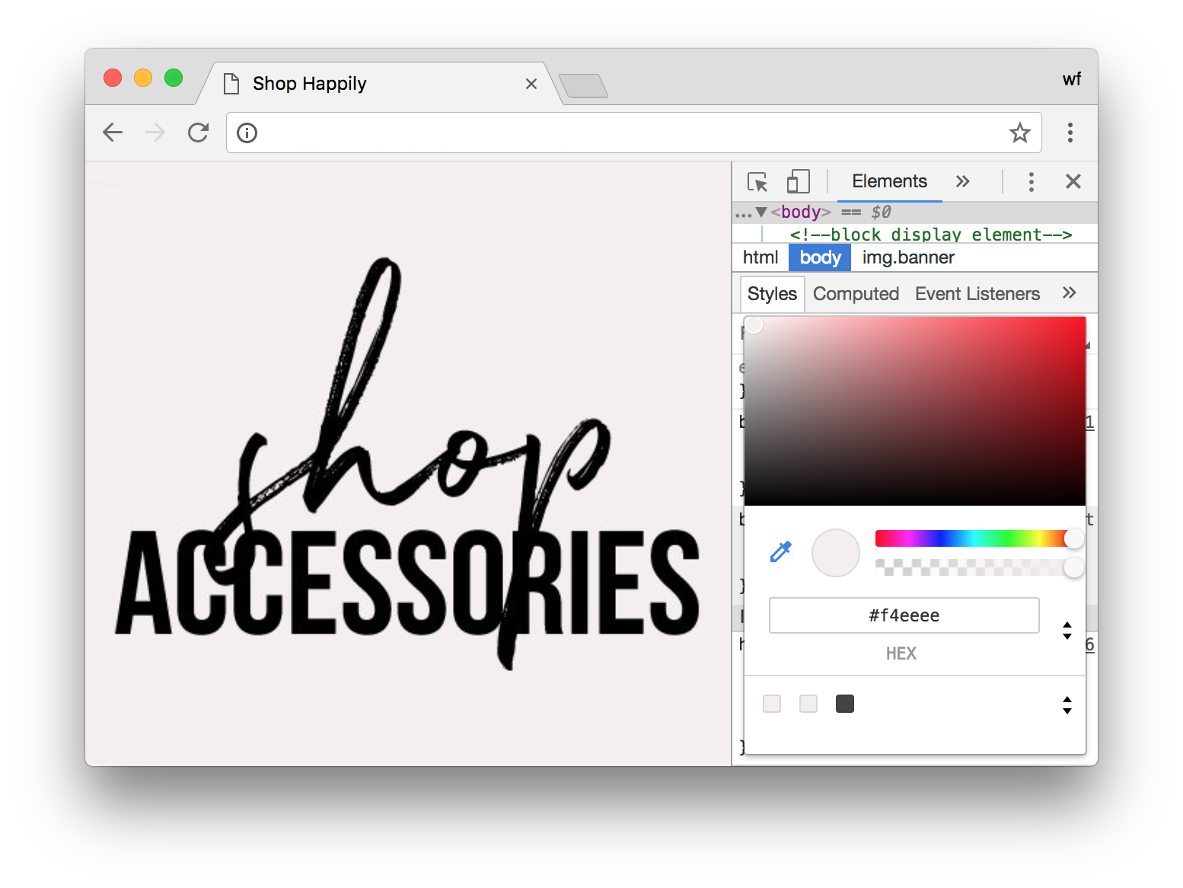
Right click > Inspect

Slide 14
Types of CSS
Inline Style
Embedded Style
External Style

Slide 15
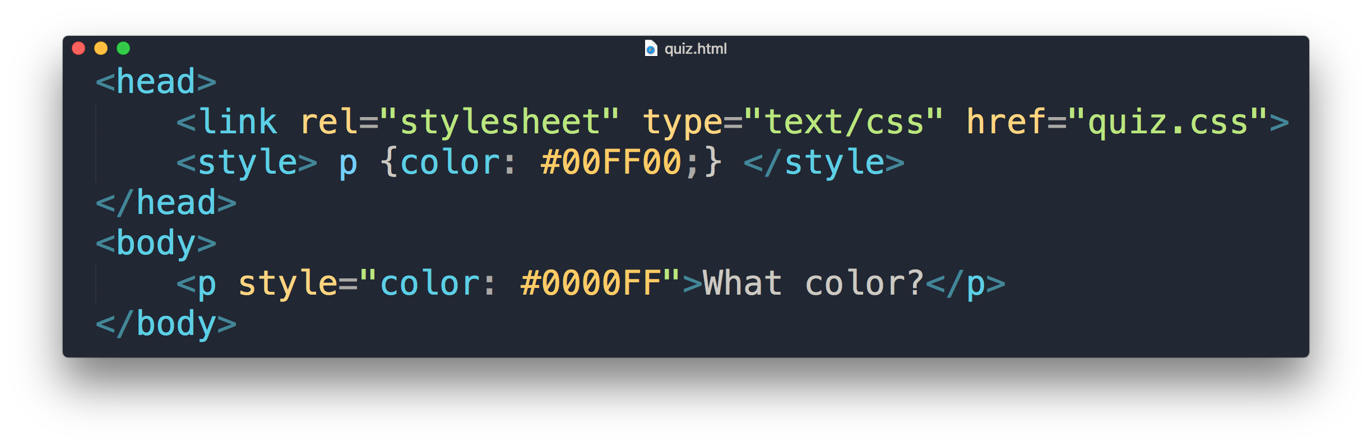
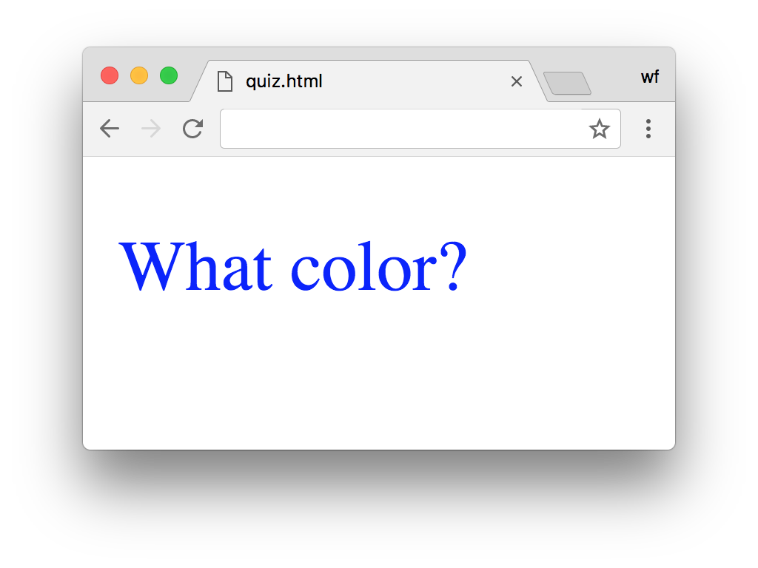
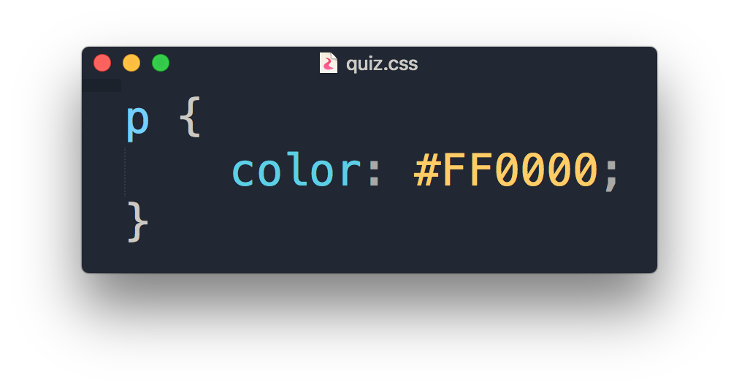
Quiz
What is the color of the output?

Slide 16
“What if I want to apply different font-sizes in two different <p> elements with external style? “

Slide 17
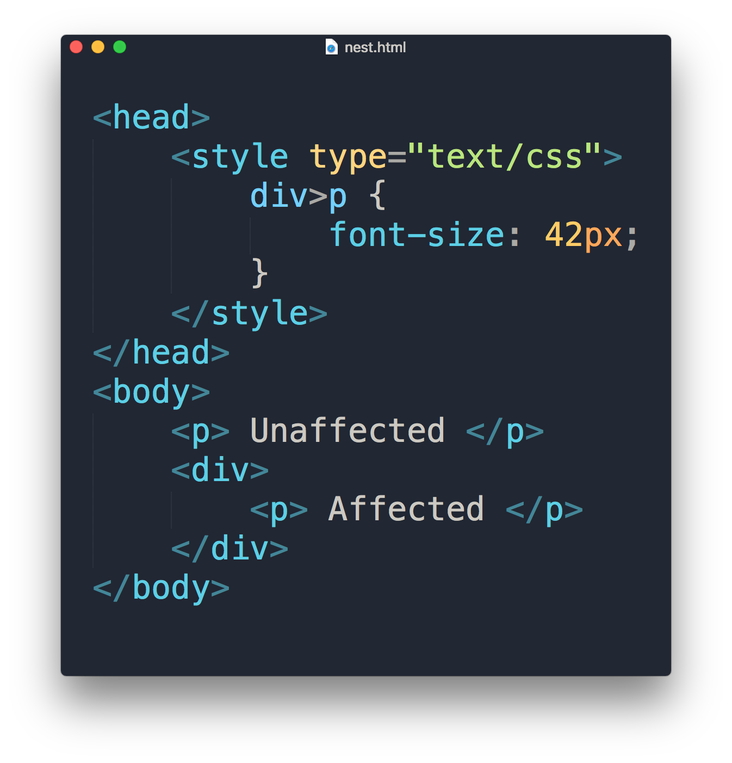


Slide 18
Selectors
div > p
div p
div, p
a:link
a:hover
a:visited
All <p> one level deep in <div>
All <p> inside <div>
All <p> tags and <div> tags
Link in normal state
Link with mouse over it
Link in visited state

Slide 19
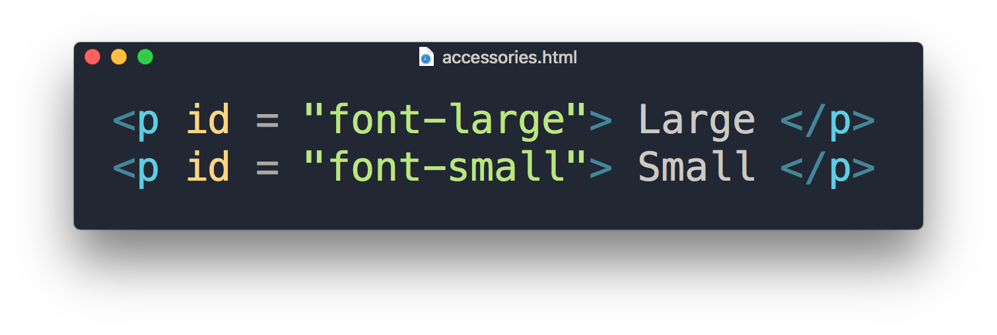
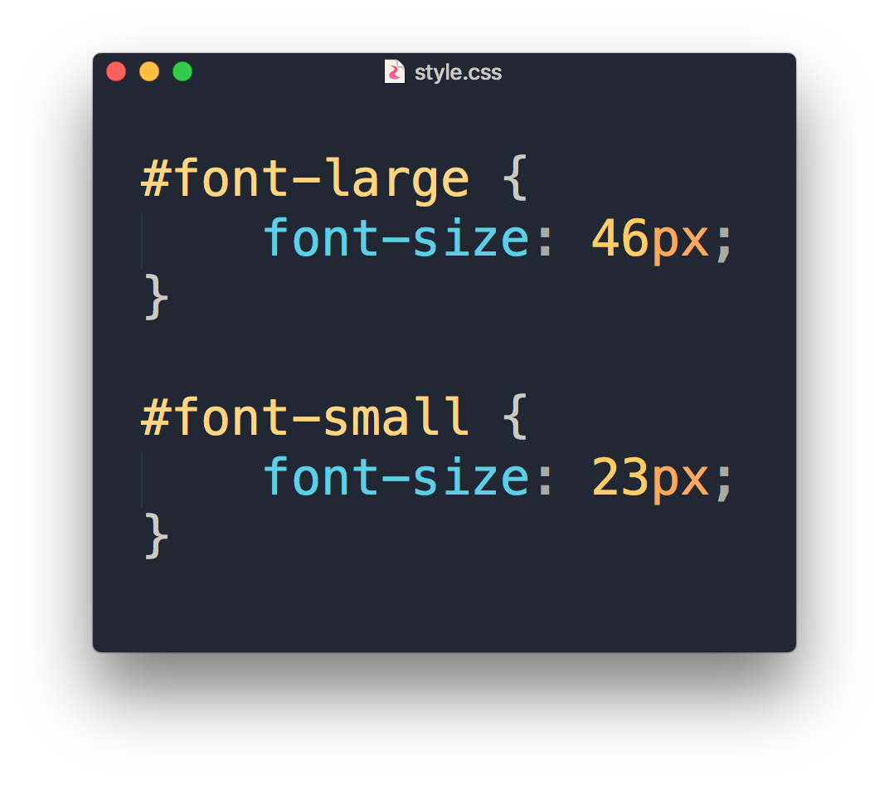
ID

Slide 20
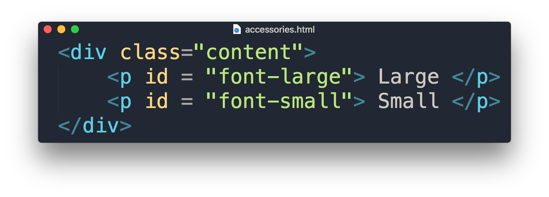
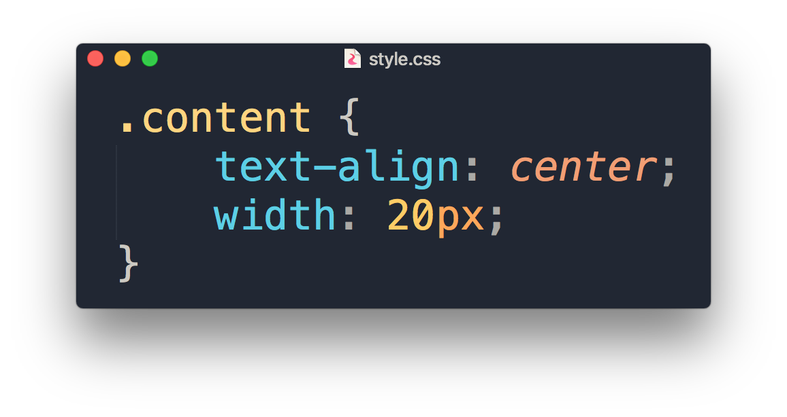
Class

Slide 21
.class
Can use same class on multiple elements.
Can use multiple classes on the same element.
To consistently style different elements.
#id
Can only be used on one element.
Each element can only have one ID.
To style single unique element.

Slide 22
COMMONLY USED CSS

Slide 23
COMMONLY USED CSS
Text and fonts
font-size
font-weight
font-family
text-align
text-decoration
The Box Model
padding
margin
border
border-radius
Visual Formatting
width
height
display
Colors and Background
background-color
color
box-shadow

Slide 24
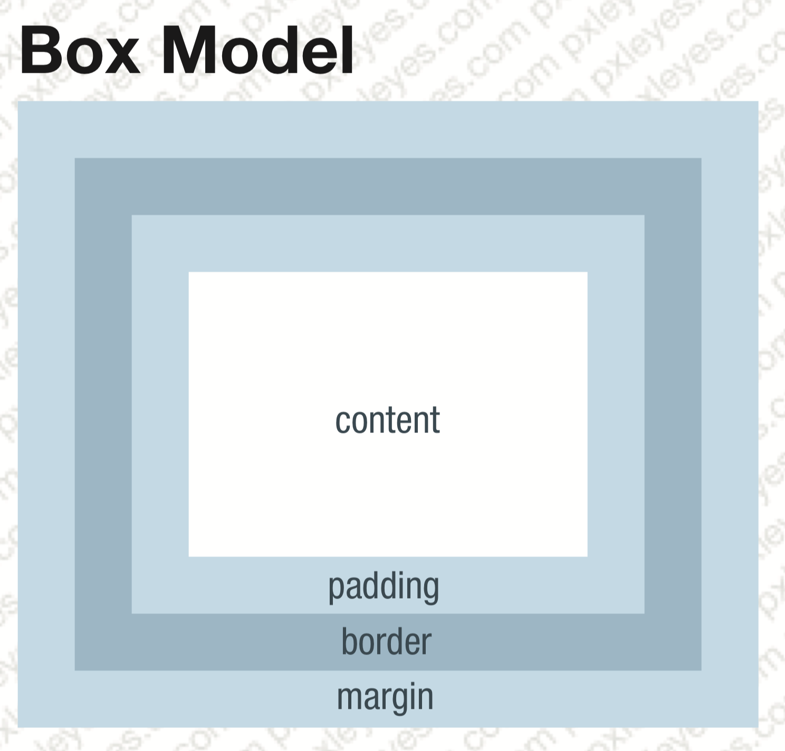
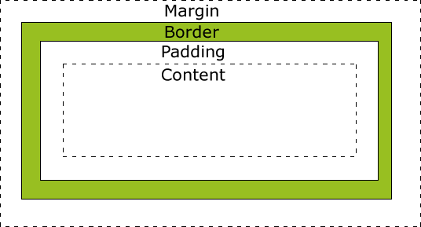
Margin & Padding
Margin, Border & Padding

Slide 25
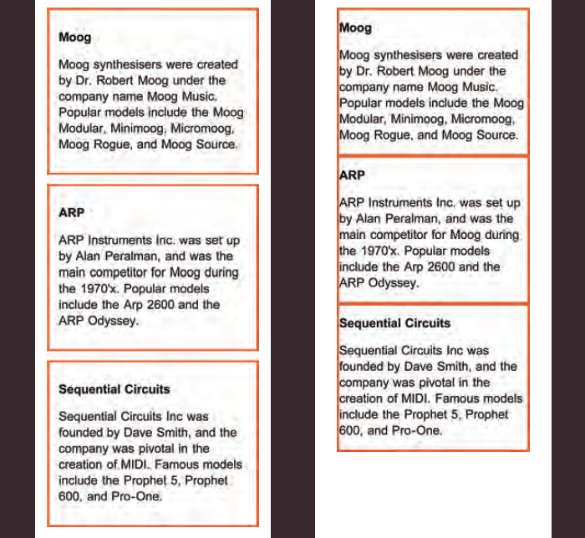
Margin & Padding
with
without

Slide 26
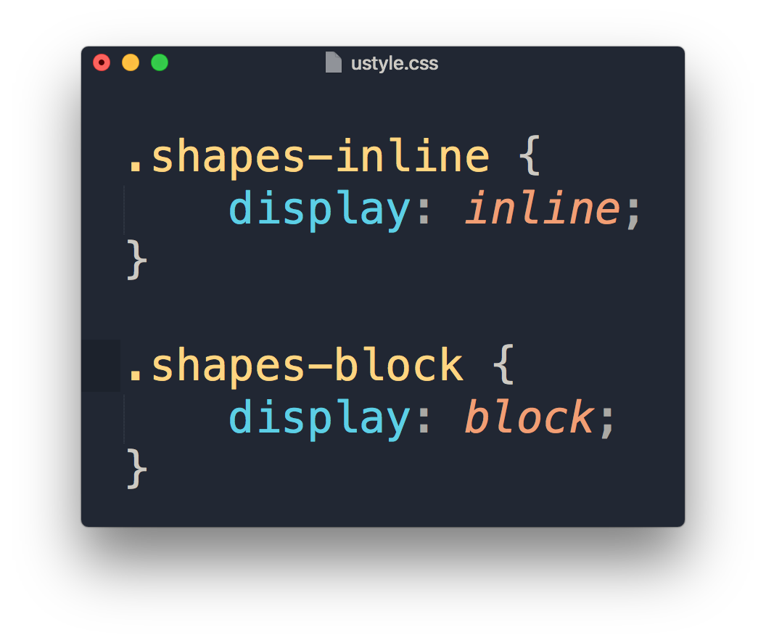
Display property
1
2
1
2

Slide 27
Demonstration

